Slide 1
MGM’s College Of Engineering and Technology,
Navi Mumbai
Crime Prediction and Reporting System
Group Members
1. Mahesh Kate (32)
2. Suyash Mhatre (41)
3. Nitin Jadhav (25)

Slide 2
Content
Introduction
Problem Definition
Literature Survey
System Architecture
Objective
Requirements
Conclusion
References

Slide 3
Introduction
In India, there has been a drastic pattern of crime observed in the past few years giving rise to a threat to the security of common man.
Considering this critical situation, we aim to study these crime patterns and realise the changes in the overall crime based on the data obtained from the official Indian Government websites.
The raw data obtained was converted to a suitable format using data mining techniques such as eliminating Null values, eliminating redundant data, data transformation, etc

Slide 4
Problem Definition
To develop a web application which is user friendly to all the stakeholders such as Invigilators, NGOs and end users, where an individual can report a crime without himself going to the police station. The system analyse various crime data of India scraped through various websites. The proposed system implements various Machine Learning algorithms and predicts the crime which is more likely to occur in the near future.

Slide 5
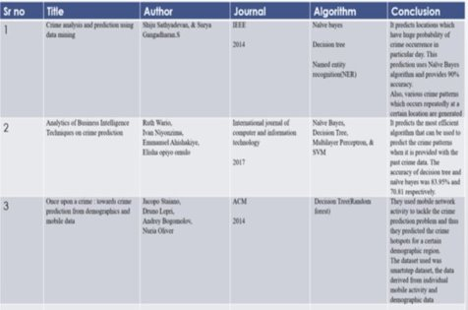
Literature Survey

Slide 6
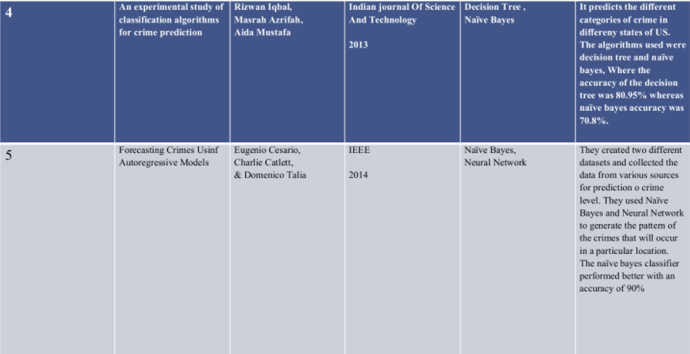

Slide 7
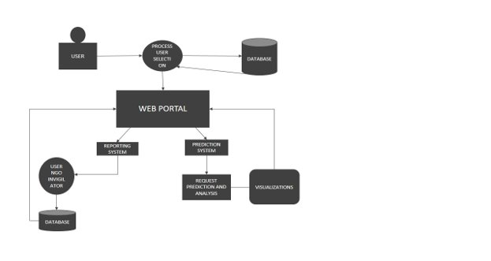
System Architecture

Slide 8
Objectives
Increasing transperancy regarding the crime in the society.
To help officials and rest concerned authorities to help them minimise the overall crime rate in India by generating insights and patterns from raw data.
Encouraging common people in bringing the crime in the eyes of justice.

Slide 9
Requirements
HARDWARE REQIREMENTS
OS : WINDOWS 7 OR NEWER, 64-BIT MAC OS, OR LINUX
SYSTEM ARCHITECTURE: 64bit x-86, 32bit x-86 witj Windows or Linux
RAM: 4GB OR greater
CPU: Intel Core 2 Quad CPU Q6600 @ 2.40GHz or greater.

Slide 10
SOFTWARE REQUIREMENTS
PYTHON3.8
WAMPSERVER FOR MYSQL
PLATFORM:
FLASK, JUPYTER NOTEBOOK, FOLIUM, etc
IDE: VISUAL STUDIO
PROGRAMMING LANGUAGES:
PYTHON, HTML, CSS, JAVASCRIPT, PHP

Slide 11
Conclusion
The proposed system is a new approach with a view to eradicate increasing crime rate in India. The crime is reported, predicted and can be analysed immediately.

Slide 12
References
Aksel I, Baran M (2006). “Organizational Problems of NonGovernmental Organizations (NGOS),”the 3rd International NGO's Congress, December 9-10, Canakkale, Turkey, ss. (Retrieved on 07 Jun 2011,http://www.turkishweekly.net/article/159/organizationalproblems-of-non-governmental-organizations-ngos-.html). Pp. 67-71
Wikipedia (2011), "Non-governmental organization," The Free Encyclopedia, http://en.wikipedia.org/w/index.php?title=Nongovernm ental_organization&oldid=188347074).
Batti, R. C. (2012). Challenges facing local NGOs in resource mobilization. Humanities and Social Sciences 2(3), 57-64. doi: 10.11648/j.hss.20140203.12
[4]Laura Skillen: Lessons Learned By NGOs In The Fight Against Human Trafficking : https://www.researchgate.net/publication/309417537 October 2016, Reasearch gate(2016)
[5] Gilder Lehrman. (2014, July 30). Facts about the Slave Trade and Slavery. Retrieved 16 July 2016, from http://www.gilderlehrman.org/history-by-era/slavery-and-anti-slavery/resources/facts-about-slave-trade-and-slavery

